Slide 1

Queue
Data Structures
Dr. Bouchaib Falah

Slide 2
Queue
Stores a set of elements in a particular order
Queue principle: FIRST IN FIRST OUT
= FIFO
It means: the first element inserted is the first one to be removed
Example
The first one in line is the first one to be served
cinemark

Slide 3
Queue
 an ADT
Elements are inserted and deleted in a FIFO (First-in, First-out) manner
Placing an item in a queue is called “insertion or enqueue”, which is done at the end of the queue called “rear”.
Removing an item from a queue is called “deletion or dequeue”, which is done at the other end of the queue called “front”.
2 basic implementations:
Using arrays
Using linked lists

Slide 4
First In First Out
A
B
A
C
B
A
D
C
B
A
rear
front
D
C
B
rear
front
rear
front
rear
front
rear
front

Slide 5
Queue operations
Although we can define many operations for a queue.
Four Basic queue operations:
Queue
QueueEmpty
Dequeue (or Remove, or Serve )
Enqueue ( or Insert, or Append )

Slide 6
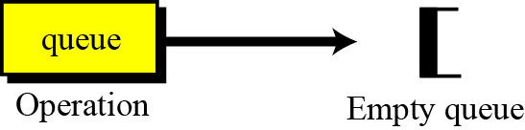
Queue operations: queue
The queue operation creates an empty queue. The following shows the format.
front is initialized to [0]
rear is initialized to [-1] (rear is less than front)

Slide 7
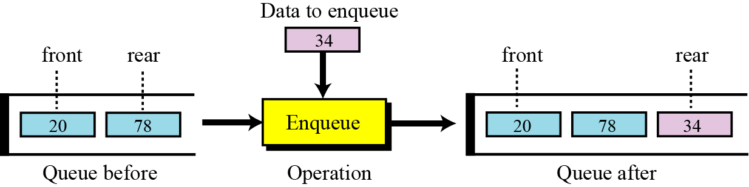
Queue operations: enqueue
The enqueue operation inserts an item at the rear of the queue. The following shows the format.

Slide 8
Queue operations: enqueue
void Enqueue ( element e)
{ // rear moves
if (! QueueFull( ) )
Arr[++rear] = e;
}

Slide 9
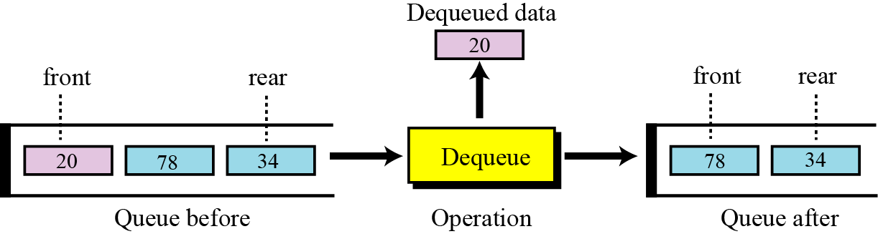
Queue operations: dequeue
The dequeue operation deletes the item at the front of the queue. The following shows the format.

Slide 10
Queue operations: dequeue
element Dequeue( )
{ // front moves
if (! QueueEmpty( ) ) return Arr[front++];
}

Slide 11
Queue operations: queueEmpty
The empty operation checks the status of the queue. The following shows the format.

Slide 12
Queue ADT
We define a queue as an ADT as shown below:

Slide 13
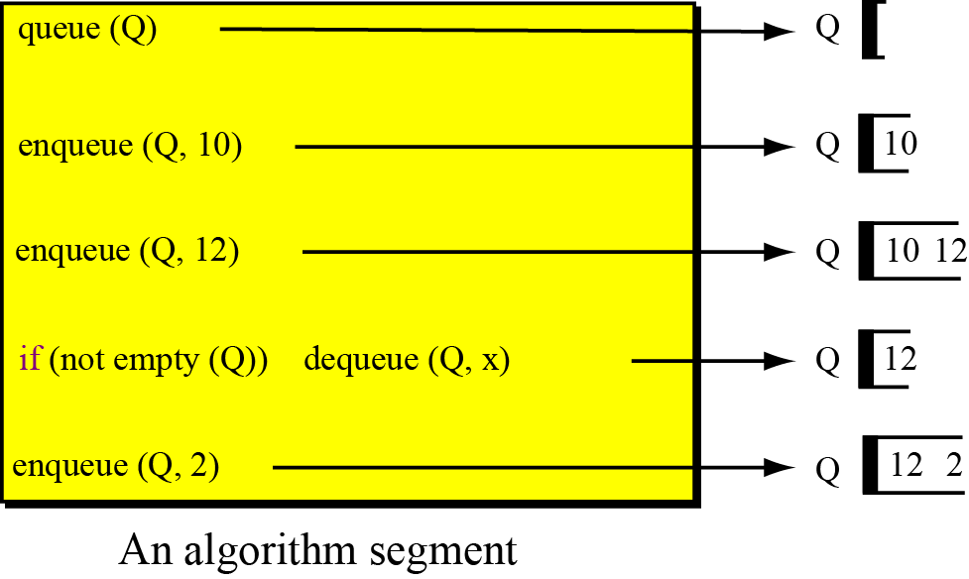
Algorithm Segment Example

Slide 14
Queue Implementation as Array
Time Complexity
enqueueing and dequeueing: O(1)

Slide 15
Queue Implementation
The drawbacks with the ‘Array Implementation’ are the lack of Dynamic Memory Allocation. i.e:
There is a limit for ‘enqueing’ which depends on the size of the queue!
MaxSize has to be guessed
Memory is still allocated even though elements are dequeued

Slide 16
Queue as a Linkedlist
Queue as a linked list
enqueue: add to the list at the back (append)
dequeue: remove from the list at the front
empty: null list
full: not relevant (modulo dynamic memory limits)

Slide 17
Exercise
Create a student node struct that has two members: name (string) and a gpa (double). Implement a queue as a linkedlist where you prompt the user to enter three students and then print the whole content of the queue. Then dequeue all students from the queue and print the contents of the queue after each deletion.
Refer to the output screen shot in the next slide

Slide 18
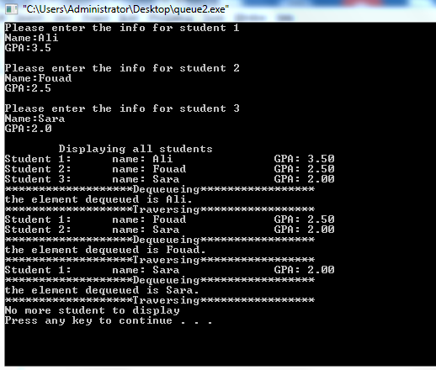
Exercise: Expected Output

Slide 19
Queue Applications
Real life examples
Waiting in line
Waiting on hold for tech support
Applications related to Computer Science
Threads
Job scheduling (e.g. Round-Robin algorithm for CPU allocation)

Slide 20
A Typical Usage of Queues Job Scheduling
Printers:
Printers keep a job queue where users requests are enqueued.
Once the printer completes its current job, it does select the next job from the queue.
To add more flexibility, multiple queues are used to handle priorities. Hence, jobs kept in the high-priority queues take precedence over the ones in low-priority queues.
Priority can be determined by a variety of things: waiting time, rank, value…

Slide 21
A Typical Usage of Queues Job Scheduling
In Operating Systems:
The CPU processes jobs in a Round-Robin Scheduling manner where the OS keeps a Queue where jobs from different programs are enqueued .

